Slide 1
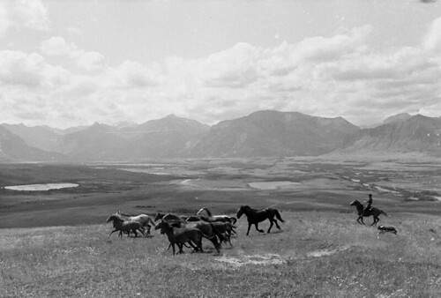
Marco Navarro-Génie, PhD Haultain Research Institute @mnavarrogenie @haultain_org
Think Tanks Matter!

Slide 2
Think Tanks
Driven by ideas
Move and advance debates
Advance liberty and resist the curtailing of freedom
Not partisanship and not advocacy
Train and develop leaders
Influence public and decision-makers
@mnavarrogenie

Slide 3
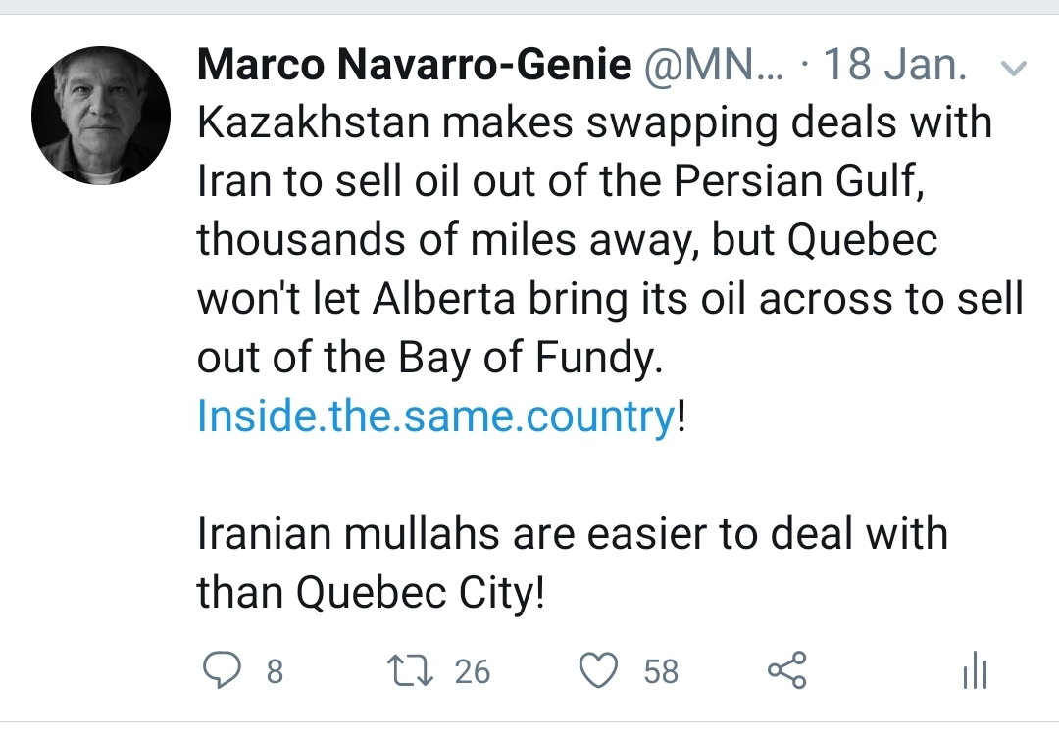
Influence
“They’re having an easier job building a similar pipeline across the 28 member states of the European Union than we can in Canada. This is just bizarre,” Jason Kenney in Vancouver Sun-Jan. 28, 2020
@mnavarrogenie

Slide 4
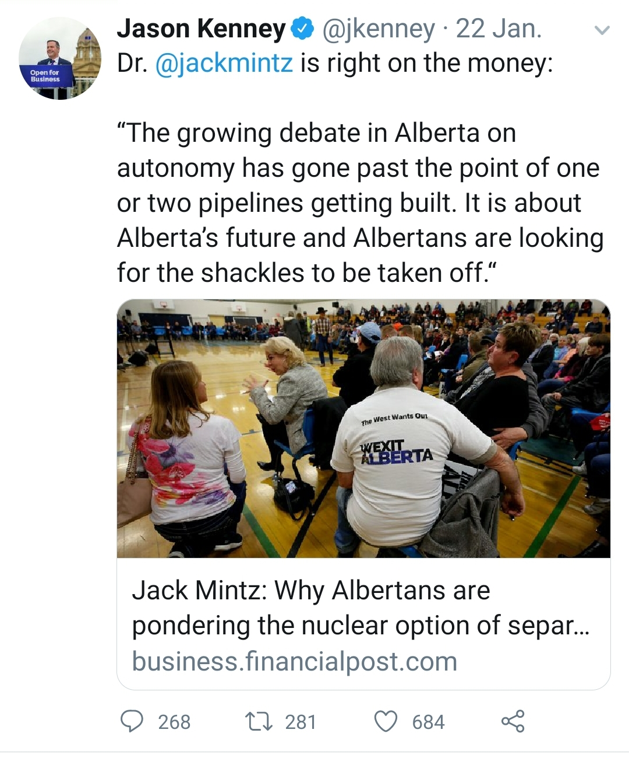
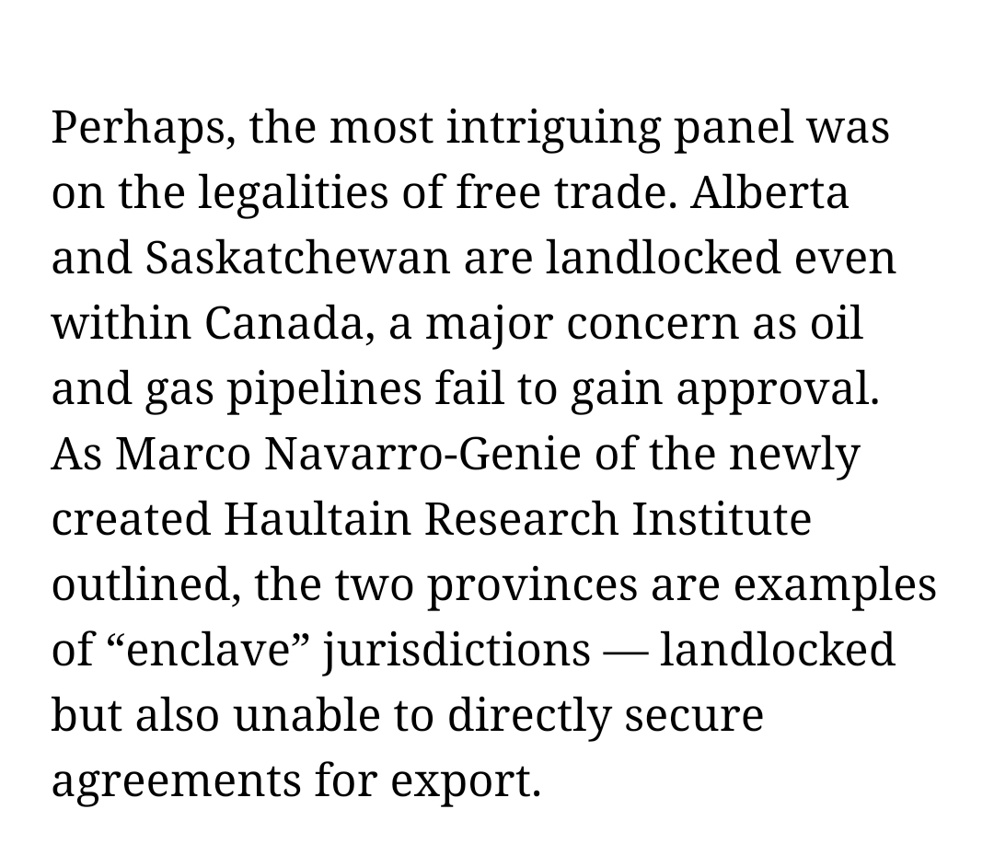
Influence
@mnavarrogenie

Slide 5
Think Tanks Matter.
Marco Navarro-Génie, PhD Haultain Research Institute @mnavarrogenie @haultain_org
www.HaultainResearch.org

